Slide 1
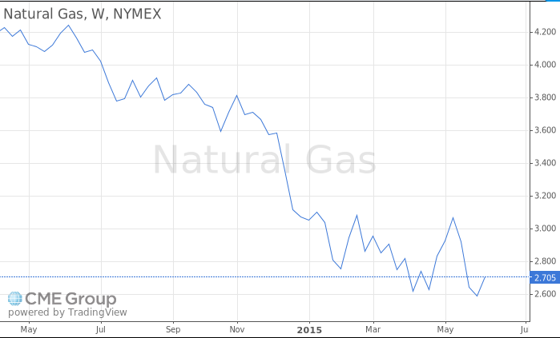
Energy Prices have decreased 37% from 2014!

Slide 2
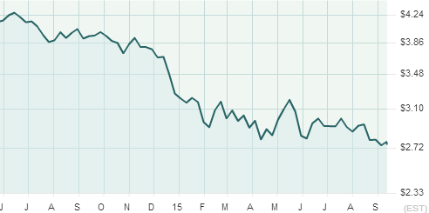

Energy Prices have decreased 37% from 2014!
Natural Gas

